Slide 1
Chapter 3 from book 1 Section 3.3 , page 37
4+1 View Model of Software Architecture

Slide 2
Outline
What is the architecture view?
The problem.
Suggested Solution
4+1 view model
Logical view
Process view
Development view
Physical view
The User Interface View
Scenarios
The Iterative process
Annotation

Slide 3
What is the architecture view?
The architecture view is a representation of a coherent set of architectural elements , as written by and read by system stakeholders.
The 4+1 Architectural View Model is a software architecture framework that extends the traditional architectural views used in software engineering to include multiple perspectives or "views" of a system.
Views are used to describe different aspects of the system's architecture, behavior, or structure to various stakeholders, such as developers, architects, project managers, and end-users.

Slide 4
Problems:
Architecture documents do not address the concerns of all stakeholders .
Different Stakeholders : end-user, system engineers, developers and project managers.
Architecture documents contained complex diagrams sometimes they are hard to be represented on the documentation.

Slide 5
Solution
Using different notations for several Views each one addressing one specific set for concerns.
Use“4+1” view model.
It was developed by Philippe Kruchten and it was created to improve the clarity and comprehensibility of software architecture descriptions and to facilitate effective communication among stakeholders in complex software projects.
Each stakeholder group needed a tailored view of the system to address their specific concerns.

Slide 6
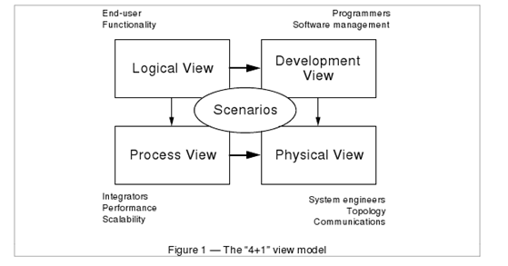
4+1 View Model of Architecture
Philippe Kruchten
Rational Software Corp.

Slide 7
Logical View
• The logical view, also called as static view, this view focuses on the functional and logical organization of the system.
Viewer: End users
considers: Functional requirements- What are the services must be provided by the system to the users.
Diagrams: class diagram, package diagram and communication diagrams

Slide 8
Process View
The process view, this view helps to understand how the software behaves at runtime, including concurrency and process/thread interactions.
Takes into account some non-functional requirements, such as performance and availability, fault-tolerance.
System administrators are interested in it for resource management and system deployment considerations.
viewer: Integrators, Developers
considers: Non - functional requirements (scalability, concurrency, and performance)
Diagrams: activity, sequence and state diagrams

Slide 9
Development View
The development view or component design view which describes subsystem decomposition
Project managers use it for project planning and resource allocation.
Quality assurance teams use it to ensure adherence to development standards and practices.
Viewer: Programmers, Project Managers, Quality Assurance Teams
No specific diagrams: Team Organization Charts, Coding Standards and Guidelines ,component diagram

Slide 10
Physical View
the physical view, engineers use it to understand the physical deployment of the software on hardware, including server configurations, network topologies. Mapping the software to the hardware
Viewer: System Engineers, System Administrators, Deployment Teams
Considers: Non-functional requirement (reliability, availability and performance). regarding to underlying hardware.
Diagrams: Deployment and network diagrams

Slide 11
Scenarios (+1 view)
(Putting all “4 views” together)
The elements in the four views are shown to work together seamlessly by the use of a small set of important scenarios —instances of more general use cases—for which we describe the corresponding scripts (sequences of interactions between objects, and between processes)
Viewer: All users and Evaluators.
Business analysts use this view to describe and understand the system's behavior in specific use cases or scenarios.
Testers use it to create test cases and validate system behavior.
End-users or clients use it to see how the system responds to their interactions.
Diagrams : Use case, Sequence and activity

Slide 12
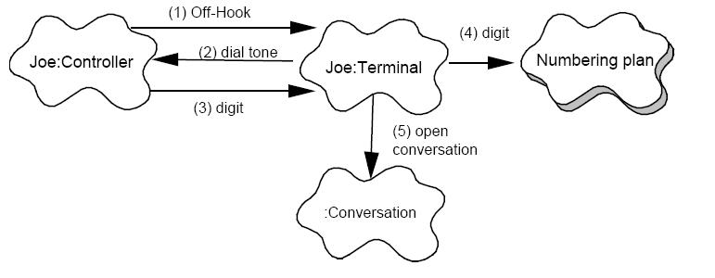
Scenario example
By Philippe Kruchten
Rational Software Corp.

Slide 13
Correspondence between the views
The views are interconnected.
Start with Logical view and Move to Development / Process view and then finally go to Physical view.

Slide 14
From logical to Process view
Two strategies :
Inside-out: starting from Logical structure
Outside-in: starting from physical structure

Slide 15
Inside-Out (Starting from Logical Structure):
Definition: Inside-out is an architectural strategy that begins with a focus on the logical or functional structure of the software system. It involves defining the system's components, modules, classes, and their relationships based on the desired functionality.
Process: Architects and developers using the inside-out approach typically start by identifying the high-level components and their interactions based on the system's functional requirements. They create a logical architecture that represents how the software's features and functions will be organized and implemented.
Advantages:
Prioritizes functional correctness and completeness.
Allows for a clear understanding of the software's core functionality.
Easier to discuss and communicate with stakeholders primarily interested in functionality.
Limitations:
May not consider non-functional requirements (e.g., performance, scalability) early in the design process.
Can lead to challenges when integrating the logical structure with the physical deployment and other non-functional aspects.

Slide 16
Outside-In (Starting from Physical Structure):
Definition: Outside-in is an architectural strategy that begins with a focus on the physical or deployment structure of the software system. It involves considering the hardware, infrastructure, and physical constraints before designing the logical or functional aspects.
Process: Architects and developers using the outside-in approach typically start by analyzing the physical environment where the software will run. This includes factors like hardware capabilities, network configurations, and deployment locations. Once they have a clear understanding of the physical constraints, they design the software's logical components to fit within this infrastructure.
Advantages:
Ensures that the software architecture is aligned with the physical environment.
Early consideration of non-functional requirements such as scalability, availability, and security.
Can help prevent architectural decisions that are difficult to implement in the chosen deployment environment.
Limitations:
May not give enough attention to the core functionality of the software.
Can lead to constraints that limit the flexibility of the logical architecture.

Slide 17
Iterative process
Not all architectures need all views.
A scenario-driven approach to develop the system is used to handle the iterative.
Documenting the architecture:
Software architecture document: follows closely “4+1” views.
Software design guidelines: it captured the most important design decisions that must be respected to maintain the architectural integrity.

